Slide 1


Status of the Evaluated Gamma-ray Activation File (EGAF)
Richard B. Firestone
Lawrence Berkeley National Laboratory
Berkeley, CA 94720

Slide 2
About EGAF
The EGAF database is the result of an IAEA CRP to evaluate thermal neutron capture cross sections (σ_{γ}) for all elements measured using guided neutron beams at the Budapest Reactor. Previously no reliable measurements existed for these data. The EGAF database is available on-line at
  Documentation: http://wwwpub.iaea.org/MTCD/publications/PDF/Pub1263_web.pdf
IAEA website: http://www-nds.iaea.org/pgaa/pgaa7/index.html
LBNL website: http://ie.lbl.gov/ng.html
Following the IAEA CRP, the LBNL Isotopes Project has organized an international collaboration to extend the content of the EGAF file to include
  Total radiative neutron cross sections (σ₀) derived from EGAF
  Activation data (P_{γ}, σ_{γ})
  Neutron separation energies (S_{n})
  Reference Input Parameter Library (RIPL) nuclear structure data
  Resonance capture γ-ray data (I_{γ},σ_{γ})
  Photon strengths (f)

Slide 3
EGAF Collaboration
LBNL – R.B. Firestone, S. Basunia, A. Hurst, A. Rogers
LLNL – B. Sleaford, N. Summers, J. Escher
NIF (LLNL) – L. Bernstein
Budapest Reactor – T. Belgya, L. Szentmiklosi
FRM II (Garching) Reactor – Zs. Revay, P. Kudejova
Charles University (Prague) – M. Krticka, F. Becvar
University of California, Berkeley – K. van Bibber, K.-N. Leung
Jülich Forschungszentrum – M. Rossbach, C. Genreith
Oslo University – S. Siem, M. Guttormsen, A.-C. Larsen
Ohio University – A. Voinov
University of Jordan – K. Abusaleem
New collaborators are welcome to join us

Slide 4
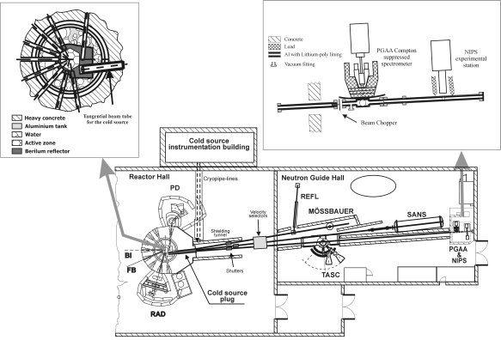
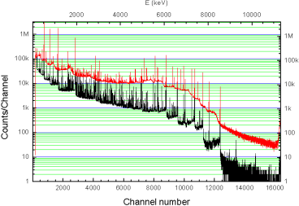
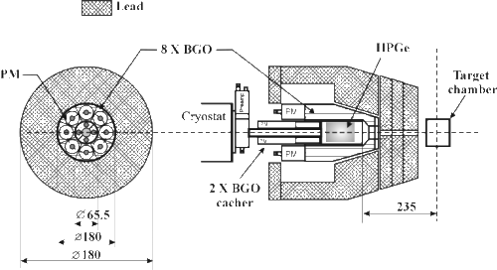
Prompt γ-ray Measurements
Guided cold or thermal neutron beams strike a target 30 m from the reactor where prompt/delayed γ-rays are detected in a Compton suppressed HPGe detector.
Efficiency known to <1% for E=0.5-6 MeV, <3% 0.05-0.5 MeV and >6 MeV.

Slide 5
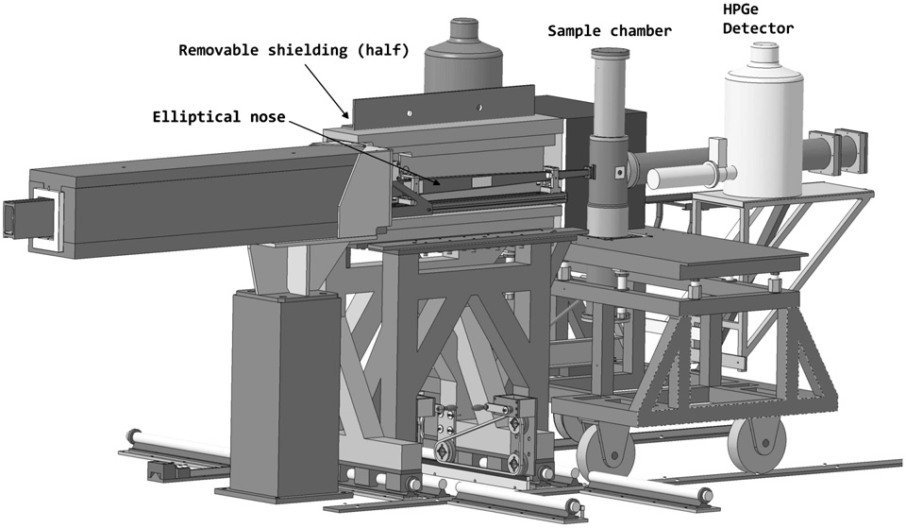
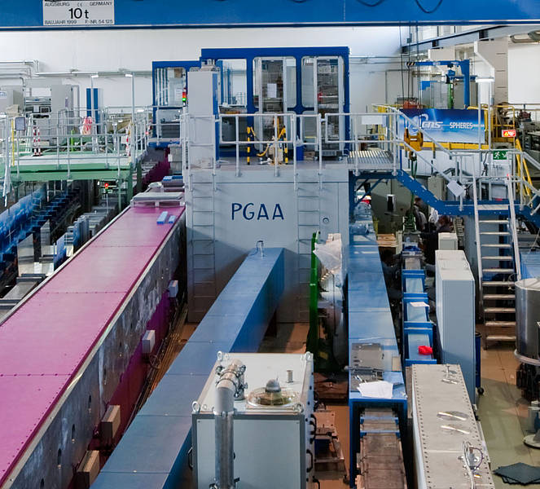
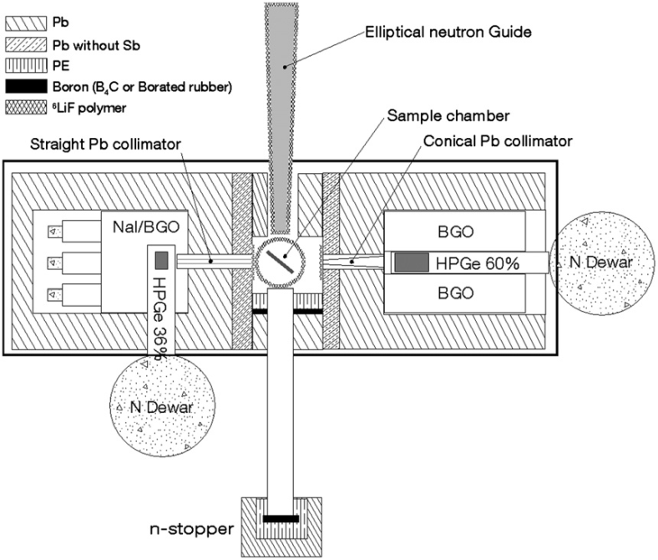
FRM II – Munich (Garching)
The neutron flux at the sample position can reach up to 6.07×10¹⁰ cm⁻² s-¹

Slide 6
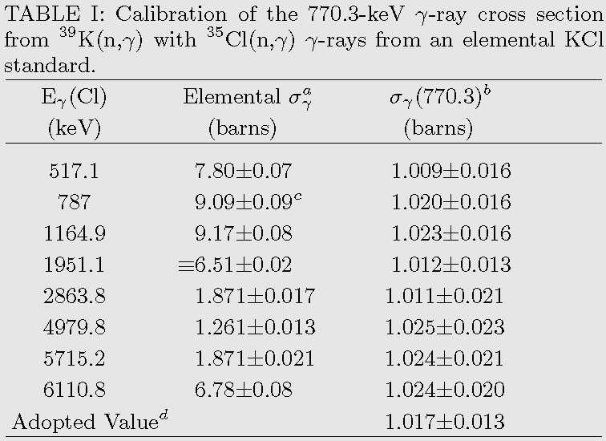
Cross section standardization
Stoichiometric compounds containing elements with well-known cross sections: H, N, Cl, S, Na, Ti, Au
    KCl, (CH₂)_{n}, Pb(NO₃)₂, Tl₂SO₄
Homogenous mixtures
Aqueous (H₂O) or acid (20% HCl) solutions, mixed powders (TiO₂)
3. Activation products with well-known P_{γ}
¹⁹F, ²⁸Al, ¹⁰⁰Tc, ²³⁵U

Slide 7
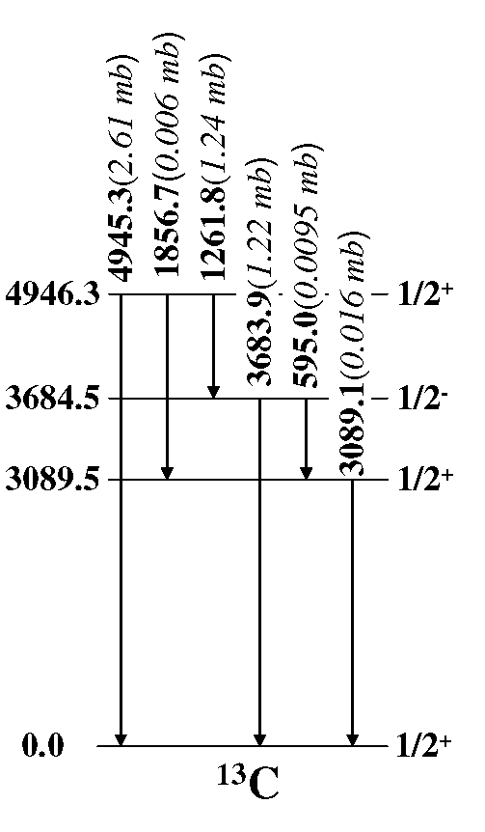
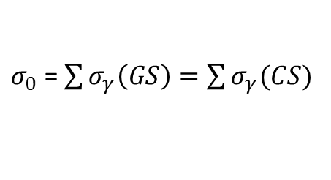
Determination of σ₀ – Light isotopes
Complete level schemes:
$σ_{0}$ =$\sum{σ_{γ}\left(GS\right)=\sum{σ_{γ}(CS)}}$
Author (Year) | σ₀±Δσ (mb)
Prestwich (1981) | 3.50±0.16
Jurney (1982) | 3.53±0.07
Nichols (1960) | 3.57±0.03
Sagot (1963) | 3.72±0.15
Jurney (1963) | 3.8±0.4
Starr (1962) | 3.83±0.06
Hennig (1967) | 3.85±0.15
Matsue (2004) | 3.81±0.11
EGAF (2007) | 3.86±0.06
Mughabghab Atlas | 3.53±0.07
σ(in) σ(out) σ(in-out)
0.0 3.86 3.86 mb
1.24 1.22 0.02
0.016 0.016 0.00
3.85 0.0 3.85 mb
The EGAF value has been benchmarked at GEEL and entered into ENDF.

Slide 8
Status of EGAF σ₀ – Light isotopes
Target | σ₀(EGAF) | σ₀(Atlas*) | Target | σ₀(EGAF) | σ₀(Atlas*)
⁶Li | 52.6(22) mb | 44.8(3) mb | ²⁶Mg | 38.8(14) mb | 38.4(6) mb
⁷Li | 46.3(13) mb | 45.2(14) mb | ²⁷Al | 232.2(17) mb | 231(3) mb
⁹Be | 8.8(6) mb | 8.5(3) mb | ²⁸Si | 186(2) mb | 171(3) mb
¹⁰B | 3.90(11) mb | 3.05(16) mb | ²⁹Si | 128(4) mb | 119(3) mb
¹¹B | 9.06(20) mb | 5.5(33) mb | ³⁰Si | 112(6) mb | 107(2) mb
¹²C | 3.86(6) mb | 3.53(7) mb | ³¹P | 169(5) mb | 165(3) mb
¹³C | 1.51(3) mb | 1.37(4) mb | ³²S | 542(7) mb | 518(14) mb
¹⁴N | 78.5(7) mb | 80.1(6) mb | ³³S | 449(7) mb | 454(20) mb
¹⁵N | 39(3) μb | 24(8) μb | ³⁴S | 285(8) mb | 256(9) mb
¹⁶O | 197(7) μb | 190(20) μb | ³⁵Cl | 44.00(20) b | 43.6(4) b
¹⁹F | 9.36(12) mb | 9.51(9) mb | ³⁷Cl | 50.0(8) mb | 43.3(6) mb
²³Na | 541(3) mb | 517(4) mb | ³⁹K | 2.28(4) b | 2.1(2) b
²⁴Mg | 535(20) mb | 538(13) mb | ⁴⁰K | 90(7) b | 30(8) b
²⁵Mg | 196(8) mb | 199(3) mb | ⁴¹K | 1.62(3) b | 1.46(3) b

Slide 9
Determination of σ₀ – Heavy Isotopes
When the (n,γ) continuum feeding is significant it can be calculated if
σ_{γ} deexciting levels below a cutoff energy E_{crit} is complete. ↓
Primary σ_{γ} populating the levels below E_{crit} from the capture state is complete. ↓
J^{π} of levels below E_{crit} are well known.
Level density ρ(E>E_{crit},J) is known.
Photon strength f(E_{γ}) deexciting or populating levels above E_{crit} is known. ↓ ↓ ↓

Slide 10
DICEBOX Statistical Model Calculations
DICEBOX is a Monte Carlo code by F. Becvar and M. Krticka (Prague). It generates complete simulated neutron capture decay schemes constrained by known nuclear properties and statistical models.
Discrete primary and secondary σ_{γ} data from EGAF
J^{π} data for E<E_{crit} from Reaction Input Parameter Library (RIPL)
Level density models
  Constant temperature (CT)
  Back-shifted Fermi (BSF) model
EI Photon Strength
  Brink-Axel (BA)
  Kadmenski, Markushev, Furman (KMF) for spherical nuclei
  Kopecky et al generalized Laurentian (GLO), temperature dep.
M1 Photon Strength
  Single Particle (SP),
  Spin-Flip (SF),

Slide 11
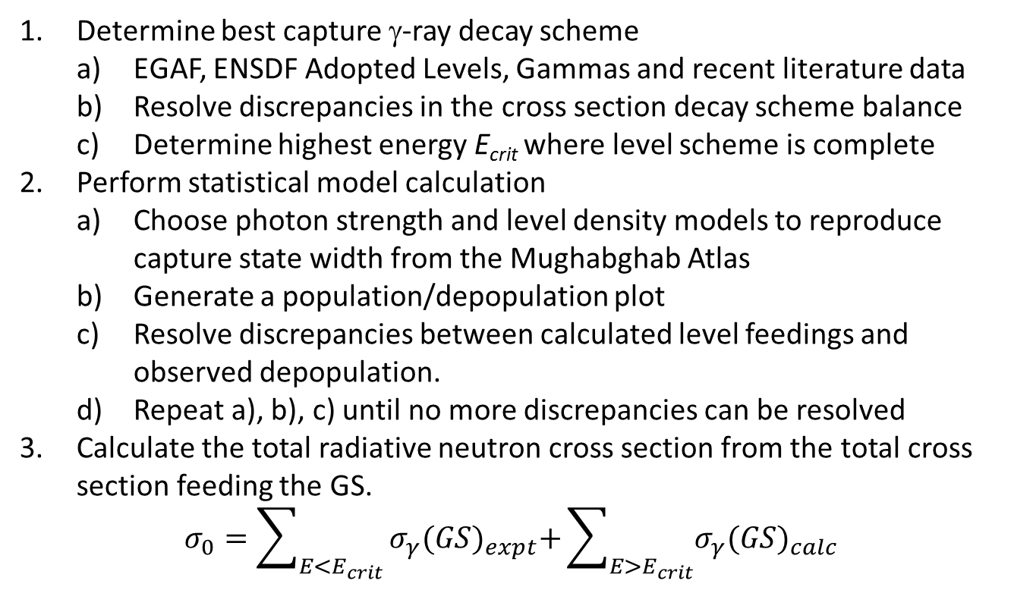
Analysis Procedure
Determine best capture γ-ray decay scheme
  EGAF, ENSDF Adopted Levels, Gammas and recent literature data
  Resolve discrepancies in the cross section decay scheme balance
  Determine highest energy E_{crit} where level scheme is complete
Perform statistical model calculation
  Choose photon strength and level density models to reproduce capture state width from the Mughabghab Atlas
  Generate a population/depopulation plot
  Resolve discrepancies between calculated level feedings and observed depopulation.
  Repeat a), b), c) until no more discrepancies can be resolved
Calculate the total radiative neutron cross section from the total cross section feeding the GS.
$$σ_{0}=\sum_{E<E_{crit}}{σ_{γ}{(GS)}_{expt}+\sum_{E>E_{crit}}{σ_{γ}{(GS)}_{calc}}}$$

Slide 12
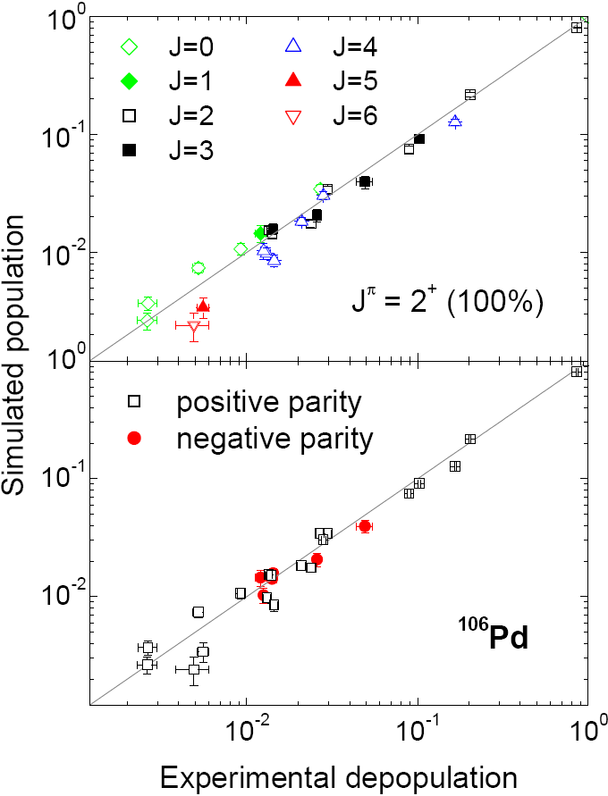
Population/Depopulation Plot

Slide 13
Status of EGAF σ₀ – Heavy Isotopes
Target | σ₀(EGAF) | σ₀(Atlas*) | Target | σ₀(EGAF) | σ₀(Atlas*)
⁶⁵Cu | 2.27(8) b | 2.17(3) b | ^{108m}Pd | 185(10) mb | 185(11) mb
⁵⁴Fe | 2.26(5) b | 2.25(18) b | ¹¹⁰Pd | 340(100) mb | 700(170) mb
⁵⁶Fe | 2.43(1) b | 2.59(14) | ¹⁵¹Eu | 6900(300) b* | 5900(200) b
⁵⁷Fe | 1.65(3) b | 2.48(30) b | ^{151m1}Eu | 2265(300) b* | 3300(200) b
⁸⁹Y | 1.34(4) b | 1.28(2) b | ¹⁵³Eu | 292(12) b* | 312(7) b
^{89m}Y | 1.9(3) mb | 1.0(2) mb | ¹⁵⁵Gd | 56300(1900) b*† | 60900(500) b
¹⁰²Pd | 1.1(4) b | 1.82(20) b | ¹⁵⁷Gd | 238900(6800) b*† | 254000(815) b
¹⁰⁴Pd | 750(60) mb | 650(30) mb | ¹⁸²W | 20.3(10) b | 19.9(3) b
¹⁰⁵Pd | 21.7(5) b | 21.0(15) b | ¹⁸³W | 10.4(4) b | 10.4(2) b
¹⁰⁶Pd | 360(100) mb | 300(30) | ¹⁸⁴W | 1.15(10) b | 1.7(1) b
¹⁰⁸Pd | 8.6(6) b | 7.6(5) b | ¹⁸⁶W | 43.2(12) b | 38.1(5) b
Work in progress
  Actinide evaluations: ²³⁷Np, ²³⁸U, ²⁴¹Pu
  Approved experiments FRM II: ^{90,91,92,94,96}Zr, ^{70,72,73,74,76}Ge

Slide 14
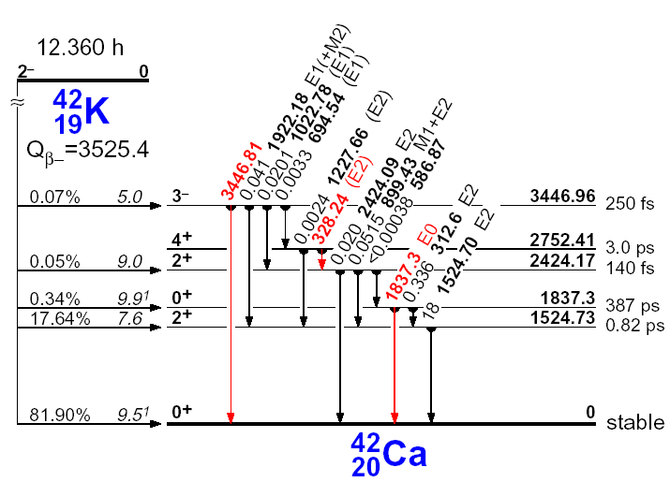
Activation Data
There is a discrepancy in the cross section determined by prompt gammas and previous values from decay measurements. From P_{γ}=σ_{γ}/σ₀ we determine P_{γ}=0.166, consistent with Kaminishi who corrected for absorption in the source.
Author (Year) | σ₀±Δσ (b) | σ_{γ}(1525)
Seren (1947) | 1.0±0.2
Pomerance (1952) | 1.19±0.10
Koehler (1967) | 1.2±0.1
Gryntakis (1976) | 1.28±0.06
De Corte (2003) | 1.42±0.02 | 0.263(2)
Gleason (1975) | 1.43±0.03 | 0.257(5)
Heft (1978) | 1.43±0.03 | 0.252(5)
Lyon (1960) | 1.45
Ryves (1970) | 1.46±0.03
Kappe (1966) | 1.49±0.03 | 0.266(8)
Kaminishi (1982)* | 1.57±0.17
EGAF | 1.62±0.03 | 0.269(5)
Mughabghab | 1.46±0.03
S_{N} 7533.80
Prompt γ
1.62(3) b
0.269(5) b
⁴²K Decay Data
Author (Year) | P_{g} (1566)
Miyahara (1990) | 0.1808(9)
Simoes (2001) | 0.1813(14)
Kaminishi (1982) | 0.171(12)
EGAF | 0.166(4)

Slide 15
RIPL Data
RIPL is widely used by statistical model codes including EMPIRE and DICEBOX in reaction calculations. RIPL is directly derived from ENSDF Adopted Levels, Gammas with modifications to account for ENSDF deficiencies.
EGAF σ₀ evaluations modify the original RIPL datasets
  Updating for more recent references
  Revising J^{π} assignments based on statistical model calculations
  Proposing new transition data based on intensity balances
A goal of EGAF is to provide improved nuclear structure data for isotopes produced by (n,γ) in RIPL.

Slide 16
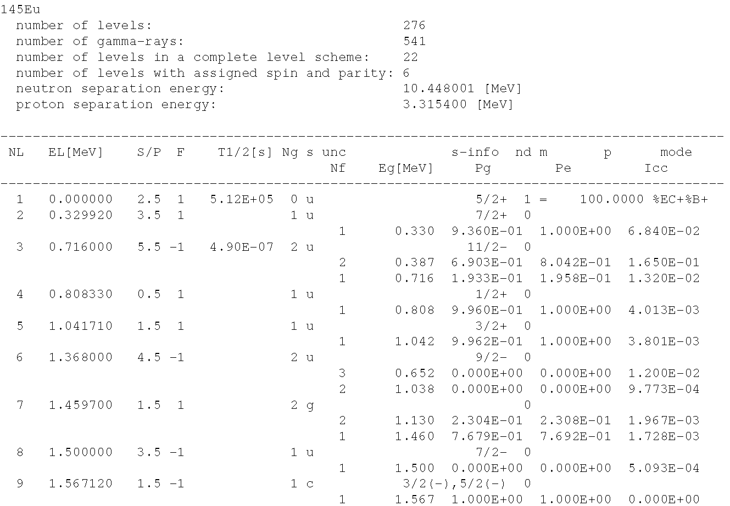
Reference Input Parameter Library
E_{crit} region of interest
Number decay modes
Spin selection criterion
Decay mode uncertainty
J
π
Missing Pγ
???
J^{π} selection
No gammas

Slide 17
Photon Strengths
Thermal Primary γ-rays
Average resonance Primary γ-rays
eV resonance primary γ-rays

Slide 18
EGAF Evaluation Path
EGAF
Prompt Data - E_{γ}, σ_{γ}, σ₀, S_{n}
Activation Data - E_{γ}, P_{γ}, t_{1/2}, σ_{γ}, σ₀
Structure data – E_{Lev}, P_{γ}, Mult/MR, f_{l}, icc
Physical Review
C
ENDF
E_{γ}, σ_{γ}, σ₀
DDEP
E_{γ}, P_{γ}, t_{1/2}, σ_{γ}, σ₀
AME
S_{n}
RIPL
E_{Lev}, P_{γ}, Mult/MR, icc
The primary evaluation effort of the LBNL Isotopes Project will be to complete the EGAF evaluation for all isotopes. Including these data in the ENSDF database would be possible

Slide 19
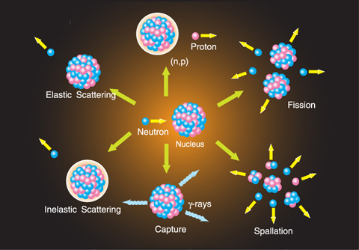
Thank you for your attention

